Slide 1
BACK TO SCHOOL!
Welcome...

Slide 2
Hello! I’m...
Mrs. Allen
This is my first year in the library, but I am excited! I love to read, so I hope you will come talk to me about books.
Every month, I will have a new book theme. This month is fun middle school books. Check out the bulletin board in the cafeteria, books displayed on top of bookshelves, and find a new slide show each month with book covers, summary, and even book trailers

Slide 3
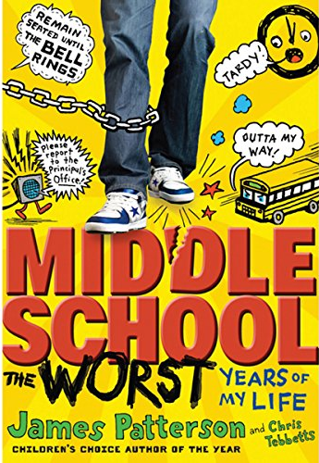
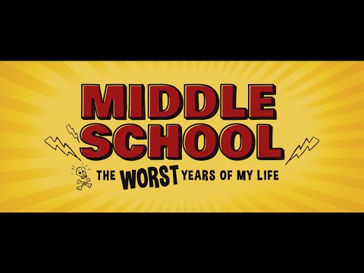
Summary
Rafe Khatchadorian has enough problems at home without throwing his first year of middle school into the mix. Luckily, he's got an ace plan for the best year ever: to break every rule in his school's oppressive Code of Conduct. Chewing gum in class: 5,000 points! Running in the hallway: 10,000 points! Pulling the fire alarm: 50,000 points! But when Rafe's game starts to catch up with him, he'll have to decide if winning is all that matters, or if he's finally ready to face the rules, bullies, and truths he's been avoiding.

Slide 4
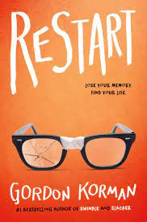
Summary
Chase's memory just went out the window. -Chase doesn't remember falling off the roof. He doesn't remember hitting his head. He doesn't, in fact, remember anything. He wakes up in a hospital room and suddenly has to learn his whole life all over again . . . starting with his own name. -He knows he's Chase. But who is Chase? When he gets back to school, he sees that different kids have very different reactions to his return. Some kids treat him like a hero. Some kids are clearly afraid of him. -One girl in particular is so angry with him that she pours her frozen yogurt on his head the first chance she gets. -Pretty soon, it's not only a question of who Chase is--it's a question of who he was . . . and who he's going to be.

Slide 5
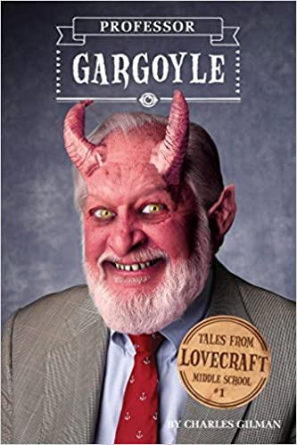
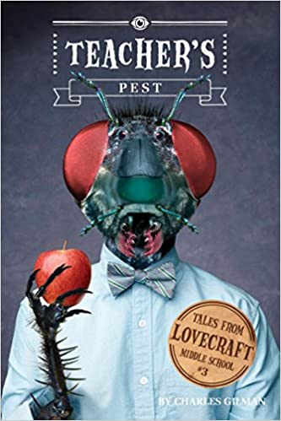
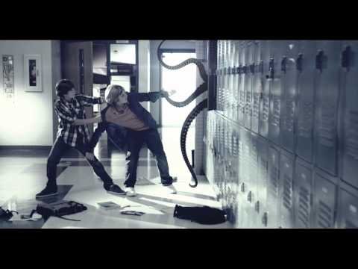
Summary
Strange things are happening at Lovecraft Middle School. Rats are leaping from lockers. Students are disappearing. The school library is a labyrinth of secret corridors. And the science teacher is acting very peculiar – in fact, he just might be a monster-in-disguise. Twelve-year-old Robert Arthur knew that seventh grade was going to be weird, but this is ridiculous!

Slide 6
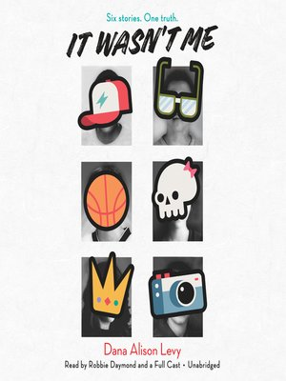
Summary
When Theo's photography project is mysteriously vandalized at school there are five suspected students who all say "it wasn't me." Theo just wants to forget about the humiliating incident but his favorite teacher is determined to get to the bottom of it and has the six of them come into school over vacation to talk. She calls it "Justice Circle." The six students—the Nerd, the Princess, the Jock, the Screw Up, the Weirdo, and the Nobody—think of it as detention. AKA their worst nightmare.That is until they realize they might get along after all, despite their differences. But what is everyone hiding and will school ever be the same?

Slide 7
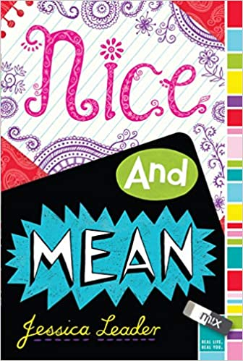
Summary
Marina is mean. Sachi is nice. Marina is Barney’s. Sachi is Burlington Coat Factory. It’s bad enough they’re forced to coexist in their middle-school’s high-profile video elective—but now they’re being forced to work together on the big semester project. Marina’s objective? Out her wannabe BFF as a fashion victim to the entire middle school. Sachi’s objective? Prove that she’s not just the smiley class pencil-lender and broaden her classmates’ cultural horizons. Work together in harmony? Yeah, that would be a "no." How can Sachi film something meaningful, and Marina, something fabulous, if they’re yoked to each other?

Slide 8
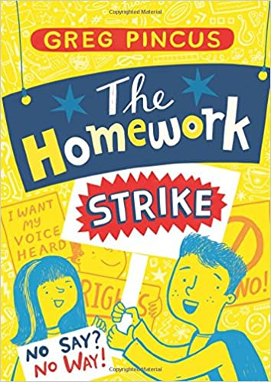
Summary
Gregory K., overwhelmed by homework, decides to make a stand -- but the stand takes on momentum of its own and Gregory has to live with the consequences. Gregory K. has too much homework. Middle school is hard work, and Gregory tries to be a good student. He participates in class, he studies for his tests -- he and his friends even help each other with their assignments. But no matter what he does, there's never enough time to finish all his homework. It just isn't fair. So Gregory goes on a total, complete homework strike. No worksheets, no essays, no projects. His friends think he's crazy. His parents are worried about his grades. And his principal just wants him to stop making trouble. Can Gregory rally his fellow students, make his voice heard, and still pass seventh grade?

Slide 9
Summary
It’s jocks vs. nerds Chub is a short, accidentally bald, middle school outcast with no chance of ever becoming one of the popular kids. With help from his personal band of like-minded misfits (not to mention tactics gleaned from the Colonel, a US military vet with toenail issues), Chub’s determined to bring down his nemesis, class hero and now potential class president, Archer, or the Arch—the very guy who betrayed Chub with the lice-killing potion that left him bald as a billiard ball. If the Arch gets to be president, Chub knows his life is officially over. Chub’s got a lot of dirt on the Arch: embarrassing photos and underwear about to fly from the school flagpole, for starters. But then he discovers that there are some very dangerous skeletons in Archer’s closet, and more at stake than just a few middle school reputations. With a lot of help from his friends, Chub sets off to bring down an evil empire—and inadvertently become the least likely hero that Alanmoore Middle School’s ever seen.

Slide 10
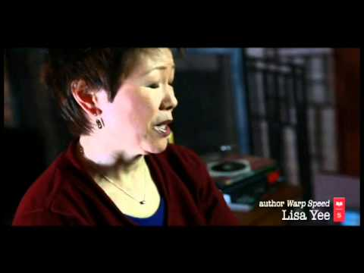
Summary
Lisa Yee returns to her core strength in older middle-grade fiction and the characters that made her famous in this "Diary of a Wimpy Trekkie."
Entering 7th grade is no big deal for Marley Sandelski: Same old boring classes, same old boring life. The only thing he has to look forward to is the upcoming Star Trek convention. But when he inadvertently draws the attention of Digger Ronster, the biggest bully in school, his life has officially moved from boring to far too dramatic . . . from invisible to center stage.

Slide 11
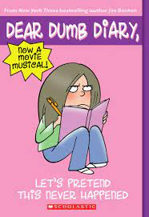
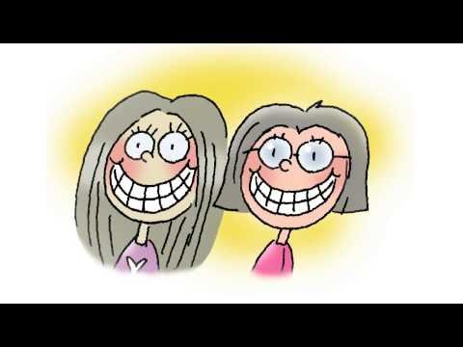
Summary
The Dear Dumb Diary books are intensely comical!
Follow Jamie Kelly on her funny adventures through middle school. Through the ups, downs, and all-arounds, she has lots of fun with her BFF, Isabella, and her tubby beagle, Stinker.

Slide 12
Summary
Future rock star or friendless misfit? That’s no choice at all.
Apple has always felt a little different from her classmates. She and her mother moved to Louisiana from the Philippines when she was little, and her mother still cooks Filipino foods and chastises Apple for becoming “too American.” When Apple’s friends turn on her and everything about her life starts to seem weird and embarrassing, Apple turns to music. If she can just save enough to buy a guitar and learn to play, maybe she can change herself. It might be the music that saves her . . . or it might be her two new friends, who show her how special she really is.

Slide 13
Summary
Maggie's still getting used to middle school. One of her teachers is, too - Mr. Carlson, her new science teacher, is blind, and is working with a guide dog for the first time. Scout is a love of a German shepherd and really wants to do his job, but Maggie can tell that Mr. Carlson's still having a hard time. Maybe she can help. . .

Slide 14
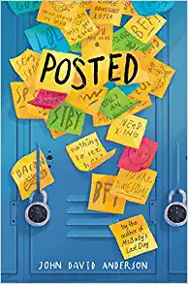
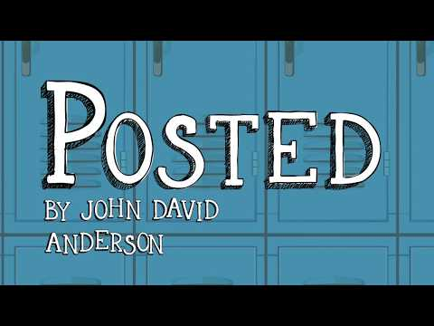
Summary
In middle school, words aren’t just words. They can be weapons. They can be gifts. The right words can win you friends or make you enemies. They can come back to haunt you. Sometimes they can change things forever.
When cell phones are banned at Branton Middle School, Frost and his friends Deedee, Wolf, and Bench come up with a new way to communicate: leaving sticky notes for each other all around the school. It catches on, and soon all the kids in school are leaving notes—though for every kind and friendly one, there is a cutting and cruel one as well.
In the middle of this, a new girl named Rose arrives at school and sits at Frost’s lunch table. Rose is not like anyone else at Branton Middle School, and it’s clear that the close circle of friends Frost has made for himself won’t easily hold another. As the sticky-note war escalates, and the pressure to choose sides mounts, Frost soon realizes that after this year, nothing will ever be the same.

Slide 15
Summary
Poor Principal Walter Russ. He's desperate for designer Florence Waters to renovate the school's disgusting basement bathrooms, and the stress is causing him to get, ahem, all clogged up. Luckily, during their stressful summer-school internships, the sixth graders discover the perfect way for everyone to relax: by enjoying an ancient Roman spa and bath buried in the school's basement!

Slide 16
Summary
After an unfortunate incident at the hair salon, Bessica is not allowed to see her best friend, Sylvie. That means she's going to start middle school a-l-o-n-e. Bessica feels like such a loser. She wants friends. She's just not sure how to make them.
It doesn't help that her beloved grandma is off on some crazy road trip and has zero time to listen to Bessica. Or that Bessica has a ton of homework. Or that gorgeous Noll Beck thinks she's just a kid. Or that there are some serious psycho-bullies in her classes. Bessica doesn't care about being popular. She just wants to survive—and look cute. Is that too much to ask when you're eleven?

Slide 17
Summary
Maureen, a thirteen-year-old self-proclaimed dork-a-saurus, is totally addicted to cupcakes and hot dogs and thinks that her body looks like a baked potato. Allergy-plagued Alice can’t touch a mango without breaking out in a rash, and if she eats wheat, her vision goes blurry. Klutzy to the extreme, Barbara is a beanpole who often embarrasses herself in front of the whole school. These outcasts don't have much in common--other than the fact that they are often targets of the ThreePees: the Pretty, Popular, Perfect girls who rule the school.
But one day Maureen discovers that the ThreePees are planning to sit next to Allergy Alice in the cafeteria and eat peanut-butter-and-banana sandwiches on whole wheat toast with mango marmalade for lunch. And Maureen decides that it's time to topple the eight-grade social regime. She joins forces with Alice and Barbara and the Nerd Girls enter the school talent show, determined to take the crown from the ThreePees. Will their routine be enough to de-throne the popular crowd? Or will their plan backfire and shake their hold on the bottom rung of the social ladder?

Slide 18
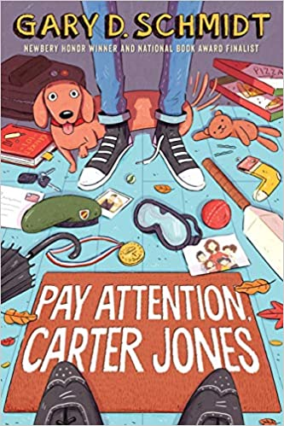
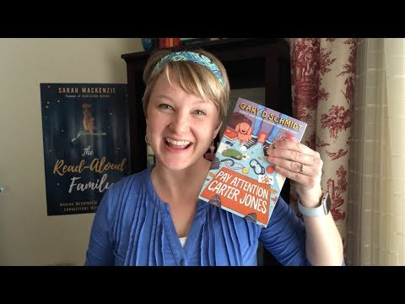
Summary
Carter Jones is astonished early one morning when he finds a real English butler, bowler hat and all, on the doorstep—one who stays to help the Jones family, which is a little bit broken.
In addition to figuring out middle school, Carter has to adjust to the unwelcome presence of this new know-it-all adult in his life and navigate the butler's notions of decorum. And ultimately, when his burden of grief and anger from the past can no longer be ignored, Carter learns that a burden becomes lighter when it is shared.
Sparkling with humor, this insightful and compassionate story will resonate with readers who have confronted secrets of their own.

Slide 19
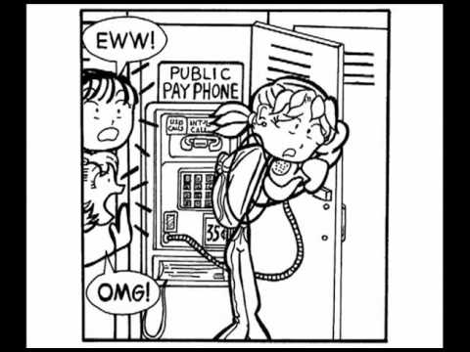
Summary
Dork Diaries series, which chronicles the oh-so-fabulous life of Nikki Maxwell as she navigates the halls of middle school, mean girls, BFF drama and first crushes.

Slide 20
Summary
Sixteen-year-old Starr Carter moves between two worlds: the poor neighborhood where she lives and the fancy suburban prep school she attends. The uneasy balance between these worlds is shattered when Starr witnesses the fatal shooting of her childhood best friend Khalil at the hands of a police officer. Khalil was unarmed.
Soon afterward, his death is a national headline. Some are calling him a thug, maybe even a drug dealer and a gangbanger. Protesters are taking to the streets in Khalil’s name. Some cops and the local drug lord try to intimidate Starr and her family. What everyone wants to know is: what really went down that night? And the only person alive who can answer that is Starr.
But what Starr does—or does not—say could upend her community. It could also endanger her life.

Slide 21
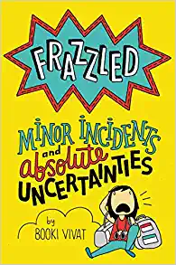
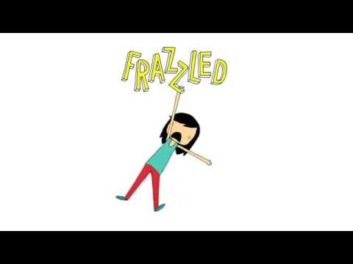
Summary
Abbie Wu thinks that she’s finally getting the hang of this middle school thing. That’s until her teacher announces that they’ll be going to…OUTDOOR SCHOOL!
While Abbie’s usual clique seems to adjust fine at camp, she doesn’t quite fit in—with anyone! If that isn’t bad enough, her camp counselors are totally evil and she can’t figure out what is up with the golden pig.
Abbie feels all alone. Will she learn how to fit in yet stay true to herself? Or will she finally reach her breaking point?
From author and professional doodler Booki Vivat, this popular series follows Abbie Wu, your favorite hilariously neurotic middle school girl, as she tries to come up with solutions to funny real-life middle school challenges.
Akin to Smile by Raina Telgemeier, Frazzled: Minor Incidents and Absolute Uncertainties is heavily illustrated, embarrassingly honest, and sure to appeal to anyone hoping to figuring out how to survive middle school.

Slide 22
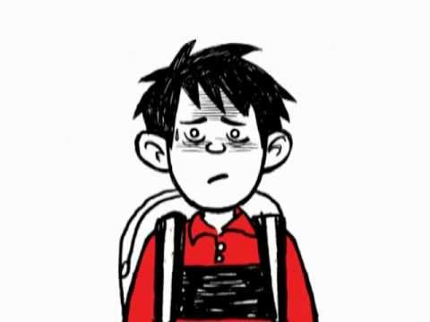
Summary

Slide 23
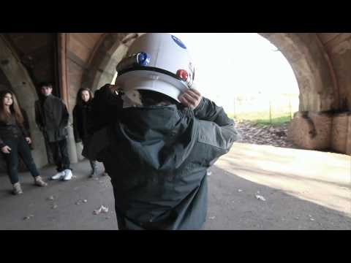
Summary
August Pullman was born with a facial difference that, up until now, has prevented him from going to a mainstream school. Starting 5th grade at Beecher Prep, he wants nothing more than to be treated as an ordinary kid—but his new classmates can’t get past Auggie’s extraordinary face. Wonder, begins from Auggie’s point of view, but soon switches to include his classmates, his sister, her boyfriend, and others.

Slide 24
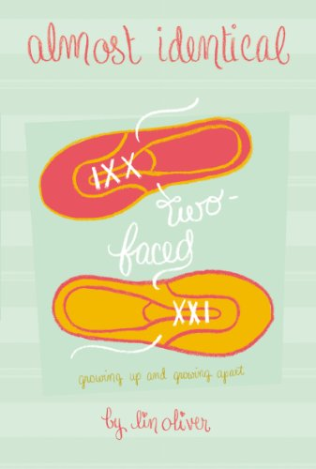
Summary
When Charlie compromises her values to help one of the popular girls cheat on a test, Sammie is inadvertantly pulled into the mess. Written from Charlie's point of view, this story will let readers experience the lengths that wanting to be popular in middle school can take you to, the conflict it can cause, and the tough moral stands a girl sometimes has to take.

Slide 25
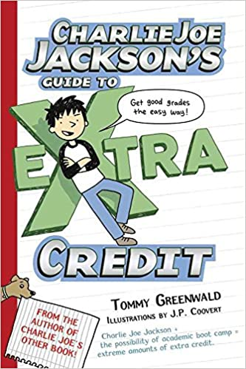
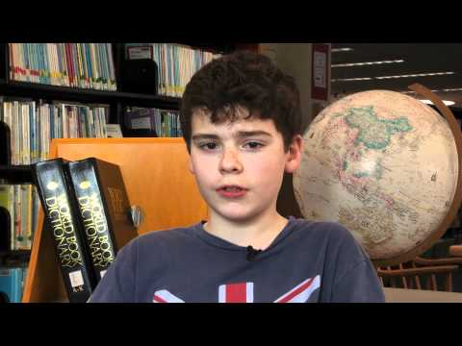
There’s a fine line between getting extra credit and having no life. Here are a few sure signs you’re doing too much extra credit: You don’t use up your maximum allowed text messages for the month. You haven’t thought about Hannah Spivero for six straight hours. The screen on your television is cold. Teachers actually smile when they see you coming.
The world’s most reluctant reader, Charlie Joe Jackson, is becoming an expert in extra credit. How is that possible? His report card is so grim that Charlie Joe has promised his parents that he’ll get straight As so they won’t send him to an academic summer camp. Now, instead of finagling ways to get out of reading, Charlie Joe is staying late after school, posing for art class, and even acting in a school play about the inventor of paper towels...all while falling for the new girl in town! If there’s one thing Charlie Joe is discovering, it’s that extra credit can definitely make your life extra complicated.

Slide 26
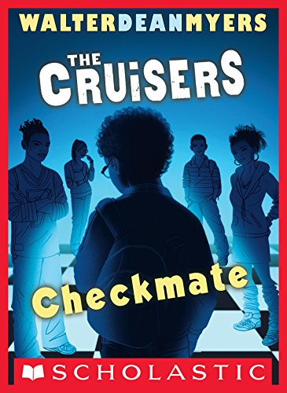
Summary
Sidney Aronofsky is one of the best chess players under age 16. When he's arrested for trying to buy drugs, it comes as a total surprise to those who know him. The expectations of parents, schools, and tutors pressure the young players. Sidney loves and wants to play chess, but dislikes the constant spotlight. He thinks that if he appears to be involved in drugs he'll be excused from playing on the school's team. In this book Zander and his creware back, using the Cruiser school newspaper express their frustrations and triumphs.

Slide 27
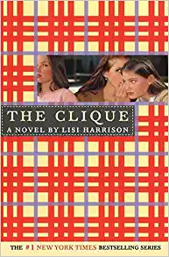
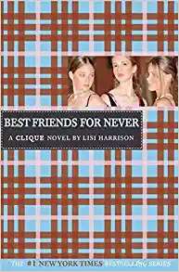
Summary
Mean Girls meets Middle School in The Clique... The only thing harder than getting in, is staying in.
Enter Claire Lyons, the new girl from Florida in Keds and two-year-old Gap overalls, who is clearly not Clique material. Unfortunately for her, while they look for a new home, Claire's family is staying in the guesthouse of the one and only Massie Block -- Queen Bee of Octavian Country Day School. Claire's future looks worse than a bad Prada knockoff. But with a little luck and a lot of scheming, Claire might just come up smelling like Chanel No. 19.
Meet the rest of the Clique:

Slide 28
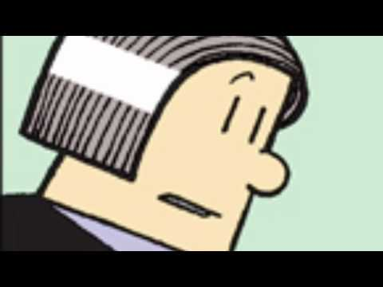
Summary
Nate knows he's meant for big things. REALLY big things. But things don't always go your way just because you're awesome. Nate barely survives his dad's toxic oatmeal before rushing off to school - minus his lunch. He body slams the no-nonsense principal. He accidentally insults his least favorite teacher, the horrifying Mrs. Godfrey (aka Godzilla). And school has barely started!
Trouble always seems to find him, but Nate keeps his cool. He knows he's destined for greatness. A fortune cookie told him so.Here comes BIG NATE, accidental mischief maker and definitely NOT the teacher's pet.

Slide 29
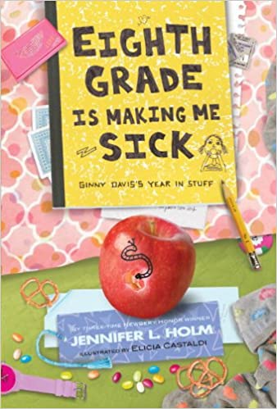
Summary
Part graphic novel, part scrapbook and altogether original—New York Times bestselling author Jennifer Holm's Eighth Grade Is Making Me Sick is just right for fans of Diary of a Wimpy Kid, Dork Diaries and Babymouse!
Ginny has big plans for eighth grade. She's going to try out for cheerleading, join Virtual Vampire Vixens, and maybe even fall in love. But middle school is more of a roller-coaster ride than Ginny could have ever predicted. Her family has just moved into a fancy new house when Ginny's stepdad loses his job. (Can worrying about money make you sick?). Ginny's big brother keeps getting into trouble. And there's a new baby on the way. (Living proof that Ginny's mom and stepdad are having sex. Just what she needs.) Filled with Post-its, journal entries, grocery lists, hand-drawn comic strips, report cards, IMs, notes, and more, Eighth Grade Is Making Me Sick is the sometimes poignant, often hilarious, always relatable look at a year in the life of one girl, told entirely through her stuff.

Slide 30
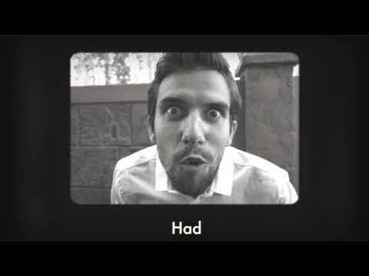
Summary
Capricorn Anderson had never watched a television show before. He'd never tasted a pizza. He had never even heard of a wedgie. And he had never, in his wildest dreams, thought of living anywhere but Garland Farm commune with his hippie caretaker, Rain.
Capricorn (Cap for short) lived every day of his life on Garland Farm growing fruits and vegetables. He was homeschooled by Rain, the only person he knew in the world. Life was simple for Cap. But when Rain falls out of a tree while picking plums and is hospital-ridden, he has to attend the local middle school and live with his new guidance counselor and her irritable daughter. While Cap knew a lot about Zen Buddhism, no amount of formal education could ready him for the trials and tribulations of public middle school.
Cap doesn't exactly fit in at Claverage Middle School (dubbed C Average by the kids). He has long, ungroomed hair, wears hemp clothes, and practices Tai Chi out on the lawn. His weirdness basically makes him the biggest nerd in school. This is great news for Zach Powers, big man on campus. He can't wait to instate the age-old tradition in C-Average School: The biggest nerd is nominated for class president -- and wins. So when Cap becomes president, he is more puzzled than ever. But as Cap begins to take on his duties, the joke starts to turn on Zach.
Will Cap turn out to be the greatest President in the history of C-Average School? Or the biggest punchline?

